Slide 1
Chapter 4 – Requirements Engineering

Slide 2
Requirements engineering
Requirements:
the services that a customer requires from a system
& the constraints under which it operates
Requirement engineering:
The process of finding out, analysing, documenting and checking the constraints on system.
Requirements may be used for :
Creating a bid for the contract
Creating a contract
Two types:
User requirements
System requirements

Slide 3
Types of requirement
User requirements
Written in natural language, non technical terms
Show the high level view of the services the system provides and its operational constraints.
Written for stakeholders/managers/non technical end users.
System requirements
A structured document
Mention the detailed descriptions of the system’s functions, services and operational constraints.
Defines what should be implemented so may be part of a contract between client and contractor.

Slide 4
stakeholders
Any person / organization who has a legitimate interest in system and is affected directly by system progress
types
End users
System managers
System owners
External stakeholders (regulatory bodies who passed the acceptance tests)

Slide 5
User and system requirements for a Hospital Management System
User requirements
System requirements
A user can make an appointment
User must have an account (sign up)
User will login to that account
Check for the specific doctor’s availability
Make an appointment
Pay the fee

Slide 6
Stakeholders for a Hospital Management System
Patients whose information is recorded in the system.
Doctors who are responsible for assessing and treating patients.
Nurses who coordinate the consultations with doctors and administer some treatments.
Medical receptionists who manage patients’ appointments.
IT staff who are responsible for installing and maintaining the system.
Health care managers who use statistics derived from the system for hospital improvement.

Slide 7
Agile’s take on requirements engineering
In agile, detailed system requirements are waste of time.
Concurrent requirement elicitation
No requirement document
express requirements as ‘user stories’.

Slide 8
Functional and non-functional requirements

Slide 9
Functional and non-functional requirements
Functional Requirements
List the services provided by the system.
Non-functional Requirements
Constraints on the services offered by the system
System’s response to a particular inputs / adverse scenario.
May state what the system should or should not do.
Includes timing constraints, constraints on the development process, standards etc.
Often apply to the system as a whole rather than individual services.
Domain Requirements
Special constraints on system enforced in case of a specific domain application
Depend on:
type of software being developed
Expected users
May relate to system properties like reliability, memory usage, response time, security, usability etc.
NF requirements may be more critical than functional requirements. If these are not met, the system might be useless.
Example:
a banking application, to ensure security, may give the authorization to user only after authentication.
To reduce response time in an embedded system, minimum hardware components are used to perform a task.
Example:
System availability or Network BW in case of a live streaming website.

Slide 10
Requirements’ dependency
Requirements are not independent.
One requirement often constraints on another requirement .
For example;
Security is a non-functional requirement
But enforcing it will create a functional requirement of user authentication facility in the system.

Slide 11
Non-functional requirements
NFRs arise through:
Organizational policies
Product requirements
External sources

Slide 12
Non-functional requirements classification
Product Requirements:
Specify constraint on runtime
Organizational Requirements:
Derive from policies & procedures in customer’s and developer's organization
Specify the platform, programming languages to be used to develop system.
External Requirements:
Requirements that are to be met necessarily to get the software approved by a regulatory body.
No ethical misuse / data leakage issue in the deployed product.

Slide 13
non-functional requirements for Hospital Management System
Product requirement The system shall be available to all clinics during normal working hours (Mon–Fri, 08:30–17:30). Downtime within normal working hours shall not exceed five seconds in any one day. Organizational requirement Users shall authenticate themselves using their ID cards. (for this to enforce, every clinic needs a card reader facility which is difficult so alternate solution is to go for some other authentication means like SMS/email. So, one NFR may lead to another FR or NFR) External requirement The system must respect patient privacy as stated in XXX-code of ethics

Slide 14
Functional requirements for a Hospital Management System
Functional requirements would be:
Sign up: Any employee/patient/doctor may register to the system
Sign In: After that he/she might be able to login.
User Id constraint: Each person using the system shall be uniquely identified by his or her 8-digit ID.
Search for doctors: A user shall be able to search the appointments lists of a doctor for all clinics.
Search for patients: The system shall generate a list of patients who are expected to attend appointments that day. (for doctors & receptionist)
Searching a doctor based on expertise: A patient can search a specialist wrt a domain
View data: Doctors can view patients history, diagnosis & medications.

Slide 15
Metrics for specifying nonfunctional requirements
Speed
Transaction time,
Size
Memory usage
Ease of use
Training time required for product usage
Reliability
Robustness
Portability
MTTF / system availability time
%age of failure occurrence
Diverse devices over which a system could run
Probability of data corruption after failure
Transaction roll back/not?
event response time
max. downtime in case of failure

Slide 16
Requirements imprecision
List every minute detail.
Less details might lead to ambiguous requirements.
Ambiguous requirements lead to requirement misunderstanding and induce system delay and increase costs
Example:
“A user shall be able to search the appointments.”
User intention – search a patient’s appointments in all clinics;
Developer interpretation – User chooses clinic first & then search for a patient name in an individual clinic. (what if the patient wants to view the appointments in multiple clinics to observe a clash?)

Slide 17
Requirements completeness and consistency
In principle, requirements should be both complete and consistent.
Complete
They should include descriptions of all facilities required.
Consistent
There should be no contradictions in the descriptions of the system facilities.
In practice, because of system complexity, it is nearly impossible to produce a complete and consistent requirements document.

Slide 18
Requirements engineering processes

Slide 19
Requirements engineering processes
depends on:
the application domain,
the people involved
and the organisation developing the requirements.
Common generic activities are:
Requirements feasibility;
Requirements elicitation and analysis;
Requirements specification;
Requirements validation.
In practice, RE is an iterative activity in which these processes are interleaved.

Slide 20
A spiral view of the requirements engineering process
High level requirements view in inner rounds
Risk analysis
Time and effort invested
Complex requirements in outer ones

Slide 21
Requirements elicitation and analysis
technical staff works with customers to find out about:
the type of application,
the services that the system should provide
and the system’s hardware constraints.
May involve:
end-users,
managers,
engineers involved in maintenance,
domain experts, trade unions, etc.
These all are called as stakeholders.

Slide 22
Requirements elicitation and analysis process
Find requirements. List all business req.
Classify as FR / NFR
Prioritize which module to implement first and remove the conflicting requirements
Requirements documented and move to next spiral round

Slide 23
Requirements discovery
gather information about the required and existing systems and extracting the user and system requirements from this information.
Techniques used are:
Interviewing
Ethnography

Slide 24

Interviewing
RE team conduct formal/informal interviews with stakeholders
Types of interview
Closed interviews: pre-determined list of questions
Open interviews: no specific questionnaire, explore req. and refine them.
Generally, a mixture of both types is used
Effective interviewing suggestions:
Be open-minded, avoid pre-conceived ideas about the requirements and are willing to listen to stakeholders.
You need to prompt the user to talk about the system by suggesting requirements rather than simply asking them what they want.

Slide 25
Problems with interviews
Communication gap between the end user and RE team.
A prerequisite knowledge related to domain is needed.
For example; Developing an e-commerce website must include transaction processing .

Slide 26

Ethnography
A person spends time to observe and analyse how people actually work.
People do not have to explain it to interviewer.
Important Social and organisational factors are observed.
Ethnographic studies have shown that work is usually richer and more complex than suggested by simple system models.

Slide 27
Scope of ethnography
Requirements are derived from the way in which people actually work rather than any pre-assumed ideal behaviour.
Based on user’s activities, you may fine tune your system design.
Good for understanding existing processes but cannot suggest innovation to a system.

Slide 28
Focused ethnography
Developed in a project studying the air traffic control process
Combines ethnography with prototyping
Prototype development results in unanswered questions which focus the ethnographic analysis.
ISSUE:
it studies existing practices which may have some historical basis which is no longer relevant.

Slide 29
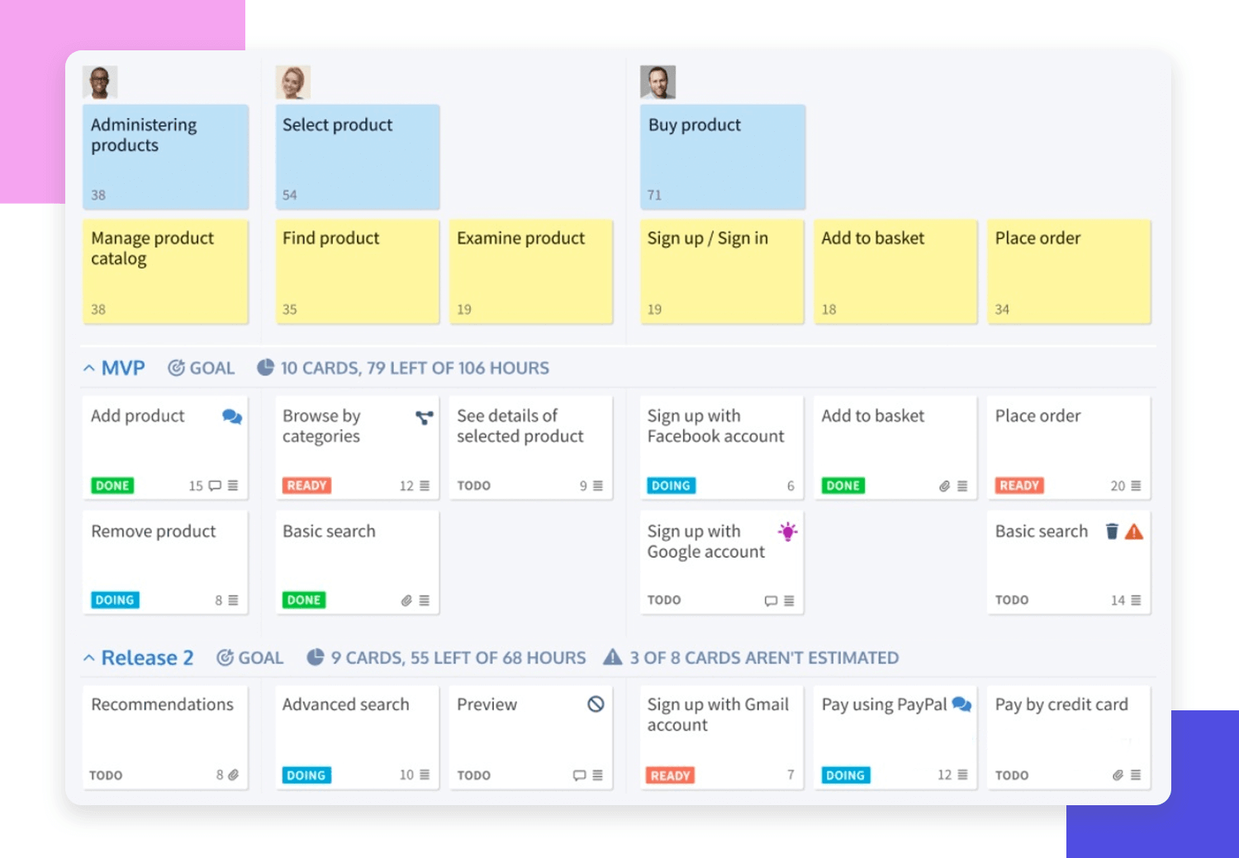
Stories and scenarios
Scenarios and user stories are real-life examples of how a system can be used for a task.
Since, it’s a practical situation, stakeholders can relate to them and can comment on their situation with respect to the story.

Slide 30
Scenarios
A structured form of user story
Scenarios should include
A description of the starting situation;
A description of the normal flow of events;
A description of what can go wrong;
Information about other concurrent activities;
Scenario’s finished state description.

Slide 31
Problems of requirements elicitation
Stakeholders don’t know what they really want.
Stakeholders express requirements in their own terms.
conflicting requirements in case of different stake holders.
Example: an HR , a stakeholder, explicitly requests to capture the age of an employee, but the Data Privacy team is saying that the age of the employee may not be captured or used in reporting.
Organisational constraints may influence the system requirements.
The requirements change during the analysis process.
New stakeholders may emerge and the business environment may change.

Slide 32
Health Club: Case Study
The XYZ Bank is developing a mobile banking application to enable its customers to manage their finances securely and conveniently on mobile devices. Customers should be able to check balances, transfer funds, pay bills, apply for loans, and track transactions from their smartphones. Given that sensitive financial data is involved.
Actors:
Primary Actor: Customer (End-User)
Secondary Actors:
Bank’s IT Team (for back-end system architecture and server management)
Security Team (for securing user data and transactions)
Business Analyst (for gathering requirements)
Mobile Developers (for creating the app for both iOS and Android platforms)
NFR:
Security
Robust
Usability
portability
performance
Memory usage.

Slide 33
E-ZShop: Case Study
"E-ZShop" aims to revolutionize the online shopping experience by providing a user-friendly interface, seamless navigation, and secure transactions. The platform allows users to browse through a wide range of products, add items to their cart, make payments, and track their orders.
NFR:
Performance
Security
Reliability
usability

Slide 34
Requirements specification

Slide 35
Requirements specification
The process of writing down the user and system requirements in a requirements document.
The requirements would be: user/system requirements.
User req.: in natural language
System req: in natural language + graphical notations + mathematical system models
Use tables, forms , diagram to elaborate system working

Slide 36
Ways of writing a system requirements specification
Natural language
Structured natural language
Graphical notations
Mathematical specifications
Written in sentences
Every sentence is a requirement
Written using standard template
Every sentence mentions details of requirements.
UML, use case and sequence diagrams
Show via finite state machines

Slide 37
Requirements and design
requirements -> what the system should do
Design -> describe how it does this.
In practice, requirements and design are inseparable
A system architecture may be designed to structure the requirements;
Multiple subsystems in design may generate new requirements;
The use of a specific architecture to satisfy non-functional requirements may be a domain requirement.
An online banking application may be built using Python to minimize the calculation time and enforce reliability.

Slide 38
Guidelines for writing requirements
Use a standard format for all requirements.
Mention the mandatory & desirable requirements separately
Highlight(Bold ,Italicize ,Underline) the key parts of the requirement.
Avoid using technical words and abbreviations.
Mention why a requirement is necessary.

Slide 39
Problems with natural language
Ambiguous requirement details
Functional/non-functional Requirements not segregated
Requirements amalgamation will lead to longer deadlines in development
e.g., “when an employee enters the building, his entry is maintained in the log and his computer shall be booted”

Slide 40
Structured specifications
Writer is limited to follow the template.
Fit for defined requirement applications. E.g. Embedded systems
Not fit for systems having evolutionary requirements. E.g., Business applications

Slide 41
Example requirements for the login module
3.1 The system shall check the username and password and as per input login the system 3.2 The system shall close the session if it left unattended for more than 5 seconds.

Slide 42
Form-based specifications
Definition of the function or entity.
Description of inputs and where they come from.
Description of outputs and where they go to.
Information about the information needed for the computation and other entities used.
Description of the action to be taken.
Pre and post conditions (if appropriate).
The side effects (if any) of the function.

Slide 43
Example requirements for the login module

Slide 44
Tabular specification
Used to supplement natural language.
Particularly useful for multiple possible alternative and courses of action.
Condition | Action
Username correct , password wrong | Login fail
Username wrong, password wrong | Login fail
Username correct, password correct | Login

Slide 45
Use cases
Use-cases are a kind of scenario that are included in the UML.
Use cases identify the actors in an interaction and which describe the interaction itself.
A set of use cases should describe all possible interactions with the system.
High-level graphical model.
UML diagrams may be added to use-cases to showcase the sequence of event processing in the system.

Slide 46
Use cases for the Mentcare system

Slide 47
The software requirements document
The software requirements document (SRD) is the official statement of what is required of the system developers.
Should include:
definition of user requirements
a specification of the system requirements.
It is NOT a design document.
As far as possible, it should set of what the system should do rather than how it should do it.

Slide 48
Users of a requirements document
customer
To have an idea of the requirements listed correctly
managers
To plan a bid for the contract
System engineers
Test engineers
Maintenance engineers
To develop system
To validate the system by writing and executing test cases
For system evolution, check change possibility

Slide 49
The structure of a requirements document
Chapter | Description
Preface | This should define the expected readership of the document and describe its version history, including a rationale for the creation of a new version and a summary of the changes made in each version.
Introduction | This should describe the need for the system. It should briefly describe the system’s functions and explain how it will work with other systems. It should also describe how the system fits into the overall business or strategic objectives of the organization commissioning the software.
Glossary | This should define the technical terms used in the document. You should not make assumptions about the experience or expertise of the reader.
User requirements definition | Here, you describe the services provided for the user. The nonfunctional system requirements should also be described in this section. This description may use natural language, diagrams, or other notations that are understandable to customers. Product and process standards that must be followed should be specified.
System architecture | This chapter should present a high-level overview of the anticipated system architecture, showing the distribution of functions across system modules. Reused architectural components should be highlighted.

Slide 50
The structure of a requirements document
Chapter | Description
System requirements specification | This should describe the functional and nonfunctional requirements in more detail. If necessary, further detail may also be added to the nonfunctional requirements. Interfaces to other systems may be defined.
System models | This might include graphical system models showing the relationships between the system components and the system and its environment. Examples of possible models are object models, data-flow models, or semantic data models.
System evolution | This should describe the fundamental assumptions on which the system is based, and any anticipated changes due to hardware evolution, changing user needs, and so on. This section is useful for system designers as it may help them avoid design decisions that would constrain likely future changes to the system.
Appendices | These should provide detailed, specific information that is related to the application being developed; for example, hardware and database descriptions. Hardware requirements define the minimal and optimal configurations for the system. Database requirements define the logical organization of the data used by the system and the relationships between data.
Index | Several indexes to the document may be included. As well as a normal alphabetic index, there may be an index of diagrams, an index of functions, and so on.

Slide 51
Requirements validation

Slide 52
Requirements validation
Process of checking that requirements are defining the system as per the customer desires.
Overlapped with elicitation and analysis phase
Since rework costs are very high so it’s one of the most critical steps
Fixing a requirements error after delivery may cost up to 100 times the cost of fixing an implementation error.
As change in requirement leads to change in design, implementation and testing as well.

Slide 53
Types of checks done to validate requirements
Validity.
Either the requirement reflecting real needs of user?
As user requirements might have changed after elicitation.
Consistency.
No contradictory constraints or requirements
No different description of a same system
Completeness.
Requirements listed must include all system’s functionality and constraints
Realism.
Verifiability.
Either a req. could be implemented via defined technology.
Could it be done in available budget, and time?
Can the requirements be checked?

Slide 54
Requirements validation techniques
Requirements review
procedure done by customer and developers
read whole requirement specification document.
Check for error, anomalies, inconsistencies
If detected
Record it
then both parties negotiate it to rectify it
Prototyping
Test-case generation/test-driven development
Involves input, output and basic functional code
Check if test cases satisfies requirements.

Slide 55
Requirements validation challenges
Its really difficult for developers & users to do the abstract analysis and find all the loop holes.
So, it is possible that the requirements may change after validation.

Slide 56
Requirements change

Slide 57
Requirements evolution
System errors
Omission in original requirements
Emerging business requirements

Slide 58
Changing requirements ~ reason 1
The business and technical environment of the system always changes after installation.
New hardware may be introduced,
business priorities may change (with consequent changes in the system support required)
Example: Installing RFID attendance system and integrate it to employees portal.

Slide 59
Changing requirements ~ reason 2
The people who pay for a system and the users of that system are rarely the same people.
System customers impose requirements because of organizational and budgetary constraints.
These may conflict with end-user requirements and, after delivery, new features may have to be added for user support if the system is to meet its goals.
Example: at first, an employee management system only contains limited necessary functionality like attendance review, leave balance and all, now users want to add their APR forms and PF statements as well.

Slide 60
Changing requirements ~ reason 3
Large systems usually have a diverse user community, with many users having different requirements and priorities that may be conflicting or contradictory.
The final system requirements are inevitably a compromise between them
with experience, it is often discovered that the balance of support given to different users has to be changed depending on priority.

Slide 61
Requirements management
It is a process of managing changing requirements during the requirements engineering process and system development.
New requirements may emerge
as a system is being developed and
after it has gone into use.

Slide 62
Requirements management
Requirements evolving
Keep track of individual req.
Maintain links b/w dependent req.
Access the impact
Make change proposal
Link it to system requirements

Slide 63
Requirements management planning
Requirements identification
Each requirement must be uniquely identified so that it can be cross-referenced with other requirements. Requirement Ids used for each requirement.
A change management process
This is the set of activities that assess the impact and cost of changes.
Traceability policies
These policies define the relationships between each requirement and between the requirements and the system design that should be recorded.
Tool support
Tools support that is offered from some requirements management systems to spreadsheets and simple database systems.

Slide 64
Requirements change management
Problem analysis and change specification
check validity of change proposal
Change analysis and costing
The effect of the proposed change is assessed using traceability information and general knowledge of the system requirements.
Change implementation
The document should be organized so that changes can be easily implemented. Like modular documentation should be done to cater changes.
pass on to change requestor
who will either suggest a better specific requirements change proposal or withdraw the request.
After analysis, proceed/not to proceed with the requirements change is decided.

Slide 65
Requirements change management

